Slide 1




BEYOND QWERTY -VOICE BASEDFORM FILLING
-KODURU NANDINI

Slide 2

Overview
1
Technologies
2
Workflow and creation
Contents
3
Project Execution
4
Learning outcomes
5
Conclusion
6

Slide 3

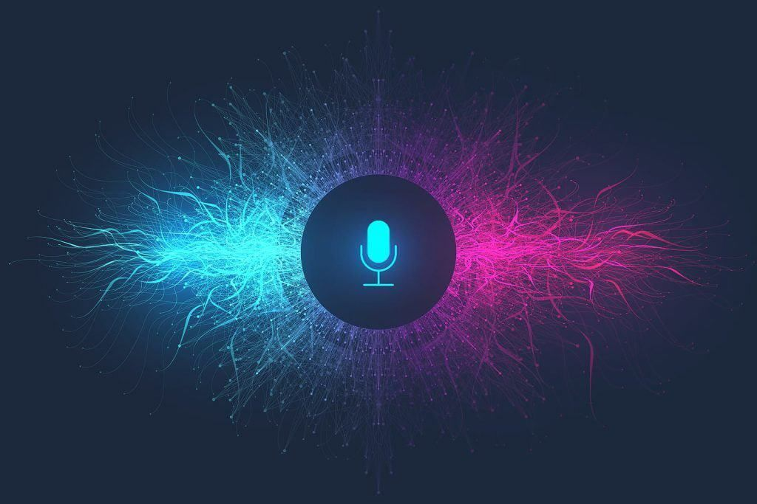

Faster Form Filling: Reduces time spent on data entry by enabling voice-based input.
Language Correction: Automatically corrects grammar, spelling, and syntax in real-time.
Context Understanding: Accurately processes complex fields like dates, addresses, and custom inputs.
Accessibility: Designed for users with physical or visual impairments.
User-Friendly: Eliminates the need for QWERTY typing, simplifying form completion.
Versatile Applications: Suitable for education, healthcare, and corporate sectors.
Increased Efficiency: Streamlines workflows and enhances user productivity.
Overview

Slide 4

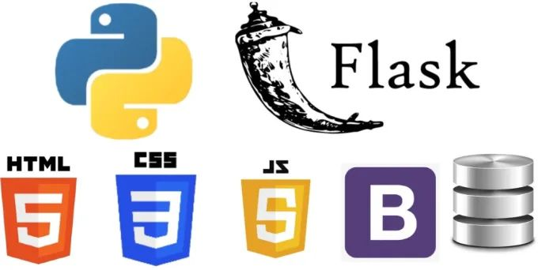
Technologies
Frontend:
HTML: Used for structuring the form and user interface.
CSS: Styles the form and ensures responsive design across devices.
JavaScript: Utilizes the Web Speech API for voice recognition and speech-to-text conversion.
Backend:
Python: Handles server-side logic for processing form data and API interactions.
Flask: Web framework to handle HTTP requests and route management.
MySQL: Database used to store form data securely.
APIs:
Google Translator API: Used to translate form data to the desired language.
Whisper API: Provides accurate speech-to-text transcription for complex voice input.

Slide 5



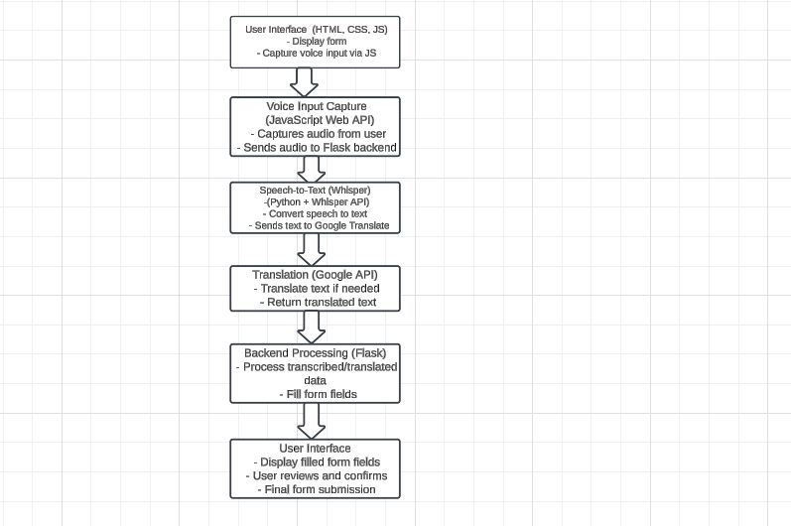
Workflow and creation

Slide 6

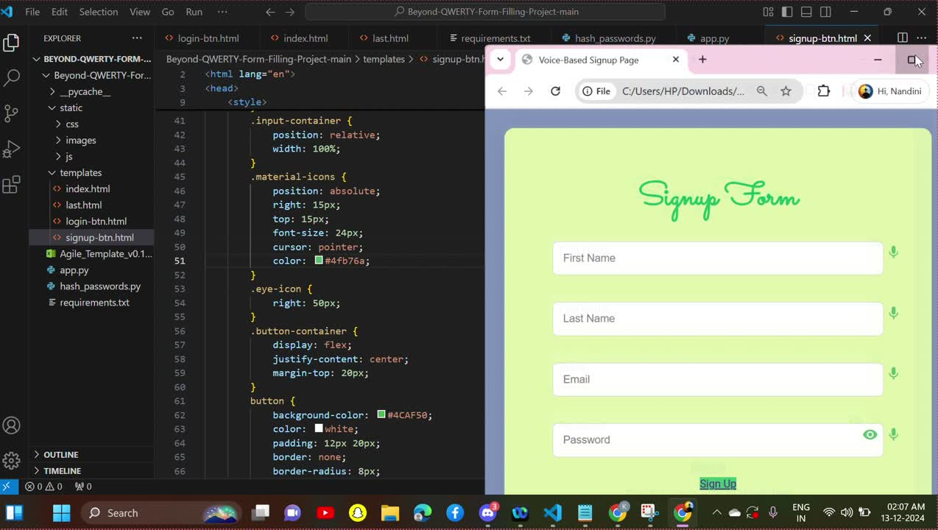
Project Execution

Slide 7

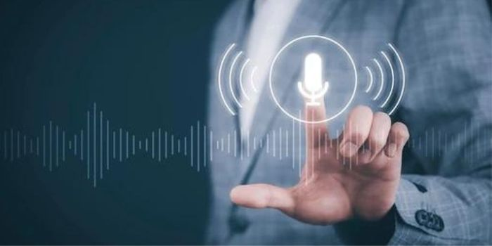

Learning outcome
Frontend Development: Gain experience in creating dynamic web forms using HTML, CSS, and JavaScript.
Backend Development: Learn how to build APIs with Flask to handle user requests and process data.
Voice Recognition: Understand how to use the Web Speech API and Whisper for speech-to-text conversion.
API Integration: Integrate third-party services like Google Translate for language translation and Whisper for transcription.
Real-Time Communication: Learn to manage real-time data flow between frontend and backend systems.
User Experience Design: Develop skills to create a user-friendly, voice-driven interface for form filling.
Machine Learning: Gain practical experience in using and deploying machine learning models like Whisper for transcription.
Deployment and Security: Understand how to deploy the application and secure user data for privacy and safety.

Slide 8
Conclusion
The shift Beyond QWERTY to voice-based form filling marks a transformative step in user interaction. It enhances accessibility, efficiency, and inclusivity, catering to users with diverse needs. By leveraging natural language processing, this technology reduces manual input errors and simplifies complex tasks. As voice interfaces become more intuitive, they promise seamless integration across industries. This innovation represents a future where technology adapts to human needs, making digital experiences more user-friendly and efficient.

Slide 9


